Slide 1
Hybrid RRAM-NEM Relay Design for Nonvolatile 3D Routing in CGRAs
Akash Levy

Slide 2
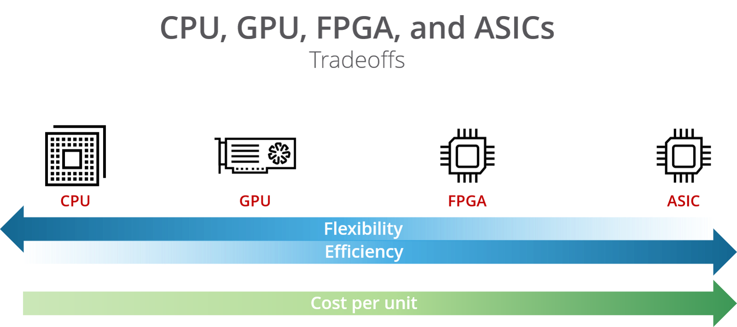
Designing an application today
Design Flow:
Code
CUDA
RTL/HLS
RTL + PNR + Tapeout
CGRA
CGRA*
CGRA
Source: https://hackernoon.com/a-gentle-introduction-to-hardware-accelerated-data-processing-81ac79c2105
* Workload-dependent
Notes:
Today we have many options for designing an application. Here’s a diagram showing the supposed tradeoffs between different application design flows.
Flexibility = What applications can be run on it
Efficiency = EDP
Cost per unit = NRE cost
We have CPUs which you run software on, GPUs which you run CUDA software on, FPGAs which you compile RTL to (or use HLS), and ASICs which have the most complex design flow.
More recently, we also have CGRAs, which are coarse-grained FPGAs, meaning they replace some LUTs with common logic structures. These have a somewhat interesting profile on this scale.
CGRAs are FPGAs that tradeoff a small amount of flexibility for a decent amount of efficiency (depending on workload though)
Same design flow should mean same cost per unit

Slide 3
Where does reconfigurability overhead come from?
LUTs are less efficient than standard cells
Increase area
Increases power and delay a little
Less of a problem for CGRAs: use more efficient logic blocks
Unutilized logic components
Increase area
Less of a problem for FPGAs: homogeneity within CLBs
Reconfigurable Routing
Increases area (80-90% of FPGA area is routing)
Increases power (5-12x)
Increases delay (3-4x)
Notes:
So we need to think about what causes this overhead. There are three main causes.

Slide 4
Reducing reconfigurable routing overhead using emerging nanotechnologies
NEM relays:
Reconfigurable switches monolithically integrated in 3D
Reduce area/power/delay overhead from reconfigurable interconnects
RRAM:
Non-volatile memory monolithically integrated in 3D
Reduce area/power/delay overhead from startup configuration
Result:
Lower routing overhead
No startup reconfiguration cost
Notes:
Result:
CGRAs become competitive with ASICs in terms of performance
CGRAs become competitive with ASICs for “normally off, instantly on”

Slide 5
Combining RRAM and NEMS approaches
RRAM and NEM relays have been separately studied for FPGAs
So what is really novel about combining approaches?
KEY POINT: If used together, the electrical properties of RRAM and NEM relays complement each other to cancel essentially all overhead

Slide 6
NEM Relays
What are they and how do they work?

Slide 7
OFF-state
ON-state
Source
Source
Beam
Beam
Gate
Drain
Electrostatic
force
Gate
Drain
(V_{B} = V_{S})
Hysteresis Window
I_{DS}
3-terminal (3T) NEM relay
Infinite subthreshold slope
V_{GS}
V_{po}
V_{hold}
V_{pi}

Slide 8
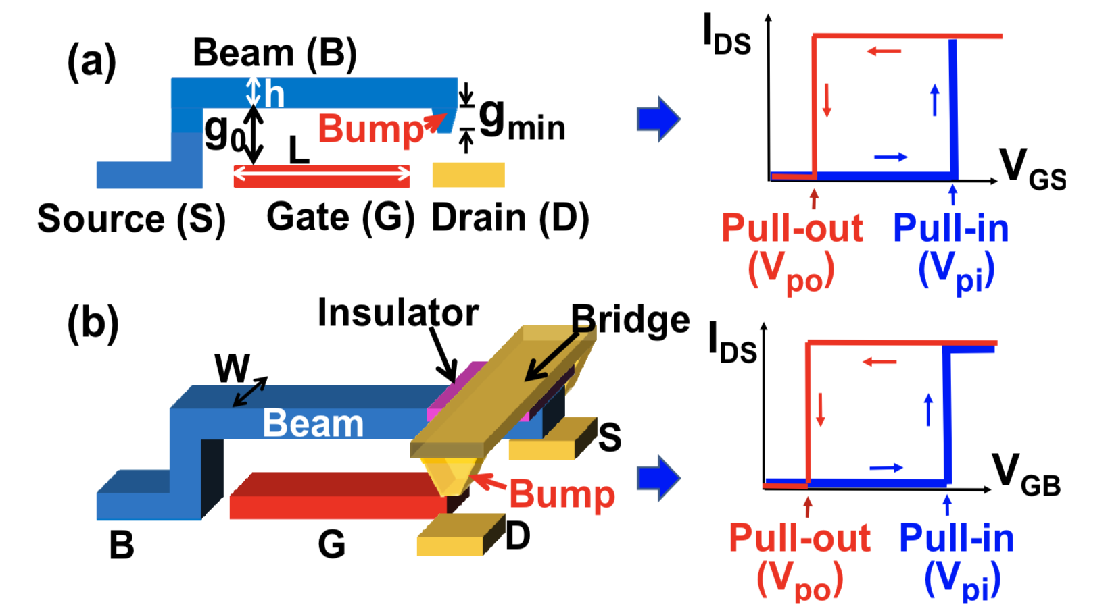
3T & 4T NEM Relays
Source: C. Chen, R. Parsa, N. Patil, S. Chong, K. Akarvardar, J. Provine, D. Lewis, J. Watt, R. T. Howe, H.-S. P. Wong, et al., “Efficient FPGAs using nanoelectromechanical relays,” in Proceedings of the 18th annual ACM/SIGDA international symposium on Field programmable gate arrays, pp. 273–282, ACM, 2010.

Slide 9
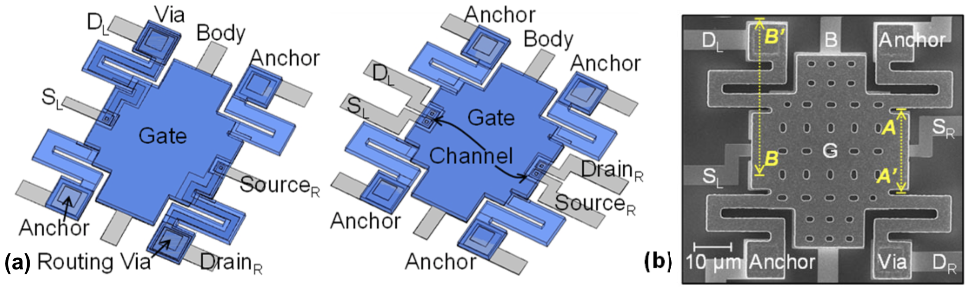
Modern Clamped-Clamped 4T NEM Relay
Source: Ye, Z. A., S. Almeida, M. Rusch, A. Perlas, W. Zhang, U. Sikder, J. Jeon, V. Stojanović, and T-JK Liu. "Demonstration of 50-mV Digital Integrated Circuits with Microelectromechanical Relays." In 2018 IEEE International Electron Devices Meeting (IEDM), pp. 4-1. IEEE, 2018.

Slide 10
New idea: multi-bit routing with NEM relays
CGRAs have multi-bit signals that need to be routed
Why not route multiple bits with a single NEM relay to save area?
Already done with two bits, want to test limits of bit-width scalability
Bit 1
Bit 2

Slide 11
Previous work on NEM relays for FPGAs
C. Chen, W. S. Lee, R. Parsa, S. Chong, J. Provine, J. Watt, R. T. Howe, H.-S. P. Wong, and S. Mitra, “Nano-electro-mechanical relays for FPGA routing: Experimental demonstration and a design technique,” in Design, Automation & Test in Europe Conference & Exhibition (DATE), 2012, pp. 1361–1366, IEEE, 2012.
3D place-and-route scheme with NEM-based LUTs and routers
Maximum of 41.9% performance gain
C. Chen, R. Parsa, N. Patil, S. Chong, K. Akarvardar, J. Provine, D. Lewis, J. Watt, R. T. Howe, H.-S. P. Wong, et al., “Efficient FPGAs using nanoelectromechanical relays,” in Proceedings of the 18th annual ACM/SIGDA international symposium on Field programmable gate arrays, pp. 273–282, ACM, 2010.
Half-select programming scheme was used for the NEM relays, verified expt.
43.6% footprint area reduction, 37% leakage power reduction, and up to 28% critical path delay reduction
Both papers used somewhat optimistic device parameters/dimensions that have not been physically realized yet

Slide 12
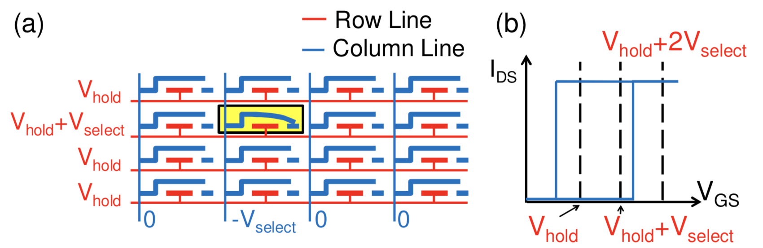
Half-Select Design for NEM Relay R/W
Source: C. Chen, R. Parsa, N. Patil, S. Chong, K. Akarvardar, J. Provine, D. Lewis, J. Watt, R. T. Howe, H.-S. P. Wong, et al., “Efficient FPGAs using nanoelectromechanical relays,” in Proceedings of the 18th annual ACM/SIGDA international symposium on Field programmable gate arrays, pp. 273–282, ACM, 2010.

Slide 13
Properties that lead to overhead cancellation
NEM Relays |  | RRAM
Good properties | Bad properties
Infinite subthreshold slope | Storage is volatile
Lower ON-state resistance than transistors | Larger than transistors
Hysteresis enables data storage | Much slower switching than transistors
3D integration | Higher V_{g} req. than CMOS
No leakage current

Slide 14
RRAM
What is it and how does it work?

Slide 15
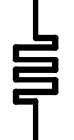
I
Top Electrode
Compliance
Resistive Switching Film
SET
=
HRS
Bottom Electrode
V_{RESET}
V
V_{SET}
RESET
LRS
Bipolar RRAM Cell
Publication & Year | VLSI 2014 | VLSI 2014 | IEDM 2014 | IEDM 2014 | VLSI 2015 | VLSI 2015
2D/3D Geometry | 2D Planar | 3D Vertical | 2D Planar | 3D Vertical | 2D Planar | 2D Planar
Switch Type | Bi | Bi | Bi | Bi | N/A | Bi
Structure | 1T-1R | 1R | 1T-1R | 1R | 1T-1R | 1R
TE/material/BE | Al/AlOx/WOx/W | TiN/HfOx/TiN | TiN/Ti/HfO2/TiN | Pt/HfOx/TiN | Ir/Ta₂O₅/TaO_{x}/TaN | TiN/TiO2/a-Si/TiN
Cell Area (μm²) | 0.0324 (.18um) | 0.000003 | 0.01 (100nm) | 1 (15nm) | 0.0016(40nm) | 0.0013
Speed [ns] | ~1000 | 50 | 40 | 20 | N/A | 10
DC Peak Voltage [V] | N/A | <3 | <3 | <2.5 | N/A | 6.5
DC Peak Current [uA] | N/A | ~500 | ~60 | ~100 | N/A | 5
HRS/LRS Ratio | >180 | >10 | 10 | 100 | 10 | 10
R high [Ω] | 3x10⁷ | 10⁶ | 2x10⁵ | 3x10⁷ | 5x10⁴ | 10⁸
R low [Ω] | 3x10⁴ | 10⁴ | 2x10⁴ | 3x10⁴ | 4x10³ | 10⁷
Endurance | 10⁹ | 10⁴ | 10³ | 10⁸ | >10⁵ | 10⁶
Retention | 10y@ 85℃ | 20000h@ 250℃ | 10y@ 70℃ | 10y@ RT | 10y @ 85℃ | 3y @ 55℃
Hysteresis in resistance
Many possible materials for resistive switching film
Many possible R/W circuit architectures
Key properties:
Endurance
Retention
Max DC current/voltage
LRS, HRS, resistance ratio
DC peak voltage

Slide 16
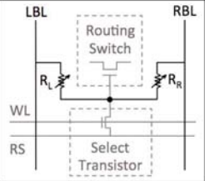
Previous work on RRAM for FPGAs
Y. Y. Liauw, Z. Zhang, W. Kim, A. El Gamal, and S. S. Wong, “Nonvolatile 3D-FPGA with monolithically stacked RRAM-based configuration memory,” in Solid-State Circuits Conference Digest of Technical Papers (ISSCC), 2012 IEEE International, pp. 406–408, IEEE, 2012.
1T2R structure with two RRAM cells having opposite resistance states
Voltage divider controlling a pass transistor
Experimentally achieved a 57% smaller die area and a 28% lower energy-delay-product (EDP) than SRAM-based design
Non-volatile configuration memory which enabled quick wake-up
Possible problems:
Leakage through RRAM during operation
Endurance/retention

Slide 17
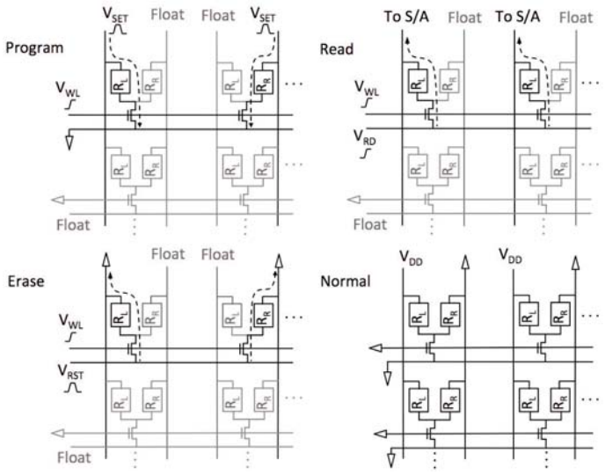
RRAM 1T2R Operation Modes

Slide 18
Properties that lead to overhead cancellation
NEM Relays |  | RRAM
Good properties | Bad properties | Good properties | Bad properties
Infinite subthreshold slope | Storage is volatile | Nonvolatile | Large write energy
Lower ON-state resistance than transistors | Larger than transistors | Lower area than SRAM and proven scalable | Sense amp to decode takes up area
Hysteresis enables data storage | Much slower switching than transistors | Resistance-based storage allows analog design
3D integration | Higher V_{g} req. than CMOS | 3D integration
No leakage current

Slide 19
How can we synergize RRAM & NEM relays?
KEY IDEA: use RRAM to control gate voltage of NEM relays for actuation
More generally: NEM relays are an interesting option for RRAM sense amplification, given their infinite subthreshold slope
NEM relays have better electrical characteristics than pass transistors

Slide 20
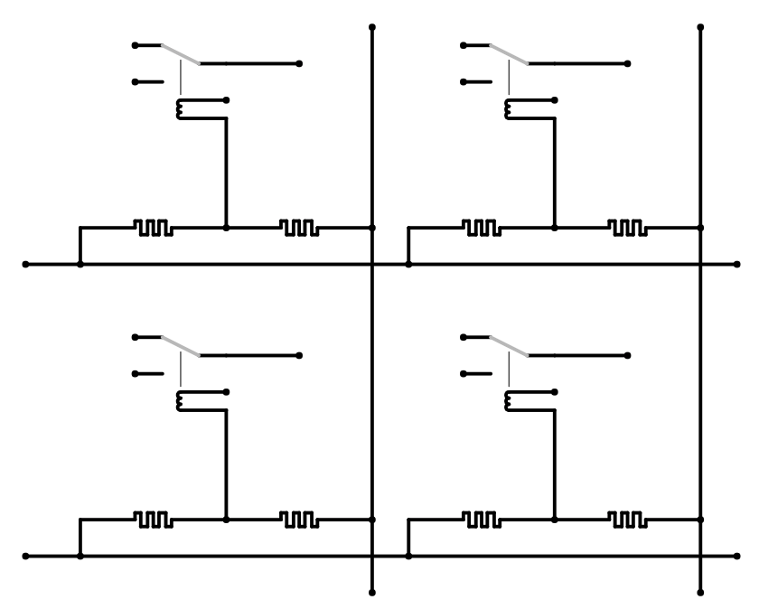
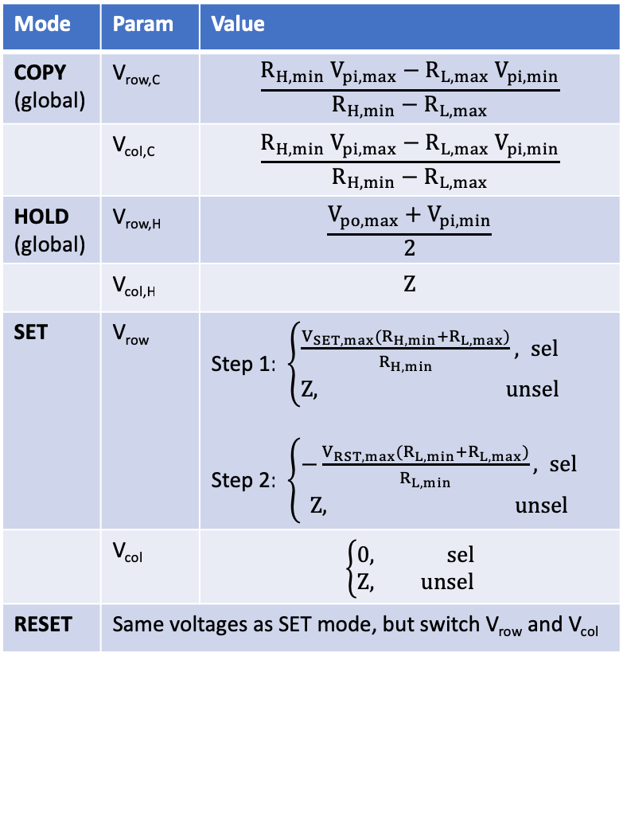
Hybrid Circuit Architecture
V_{col,1}
V_{col,2}
Mode | Param | Value
COPY (global) | V_{row,C} | $$\frac{R_{H,min} V_{pi,max}−R_{L,max} V_{pi,min}}{R_{H,min}−R_{L,max}}$$
 | V_{col,C} | $$\frac{R_{H,min} V_{pi,max}−R_{L,max} V_{pi,min}}{R_{H,min}−R_{L,max}}$$
HOLD (global) | V_{row,H} | $$\frac{V_{po,max}+V_{pi,min}}{2}$$
 | V_{col,H} | $$Z$$
SET | V_{row} | Step 1: $\left\{\begin{aligned}\frac{V_{SET,max}{{(R}_{H,min}+R}_{L,max})}{R_{H,min}}, sel \\ Z, unsel\end{aligned}\right.$ Step 2: $\left\{\begin{aligned}−\frac{V_{RST,max}{{(R}_{L,min}+R}_{L,max})}{R_{L,min}}, sel \\ Z, unsel\end{aligned}\right.$
 | V_{col} | $$\left\{\begin{aligned}0, sel \\ Z, unsel\end{aligned}\right.$$
RESET | Same voltages as SET mode, but switch V_{row} and V_{col}
src_{1,1}
src_{1,2}
drn_{1,1}
drn_{1,2}
V_{g}
-
+
+
-
V_{row,1}
src_{2,1}
src_{2,2}
drn_{2,1}
drn_{2,2}
V_{g}
V_{row,2}
out
Hysteretic 4T NEM Router
RRAM Cell
(a)
(b)
Notes:
Key idea: use RRAM to actuate the NEM relays
Entirely back-end-of-line (0T)
1N1R design
Need a good way to actuate
Poly layers are annoying to get to
RRAM properties have to match NEM relays’

Slide 21
Properties that lead to overhead cancellation
NEM Relays |  | RRAM
Good properties | Bad properties | Good properties | Bad properties
Infinite subthreshold slope | Storage is volatile | Nonvolatile | Large write energy
Lower ON-state resistance than transistors | Larger than transistors | Lower area than SRAM and proven scalable | Sense amp to decode takes up area
Hysteresis enables data storage | Much slower switching than transistors | Resistance-based storage allows analog design
3D integration | Higher V_{g} req. than CMOS | 3D integration
No leakage current
RESULT: Architecture is entirely free of transistors, so can be implemented 100% in BEOL i.e. 3D
Bad Material Property | Good Material/App Property that Cancels It
NEM relays: much slower switching than transistors | Used for routing only: only switches once on startup, hysteresis enables dual function as memory and router
NEM relays: larger than transistors | Used for routing only and integrated in 3D
NEM relays: storage using hysteresis is volatile | RRAM is nonvolatile: integration enables nonvolatility
NEM relays: higher V_{g} required than CMOS | RRAM variable resistance allows analog control of V_{g}
RRAM: larger write energy | RRAM is used as ROM
RRAM: sense amp to decode takes up area | NEM relays have infinite subthreshold slope, so single relay can act as decoder

Slide 22
Preliminary SPICE Simulations
Using simplest RRAM+NEM relay HSPICE models
Lumped models written in Verilog-A
Abrupt switching behavior (pretty unrealistic)
Not accounting for device variability, nonlinear effects, etc.
Tested all possible valid state transitions with time trace
Tested with small crossbar array (3x3)
Future work: use more accurate models

Slide 23
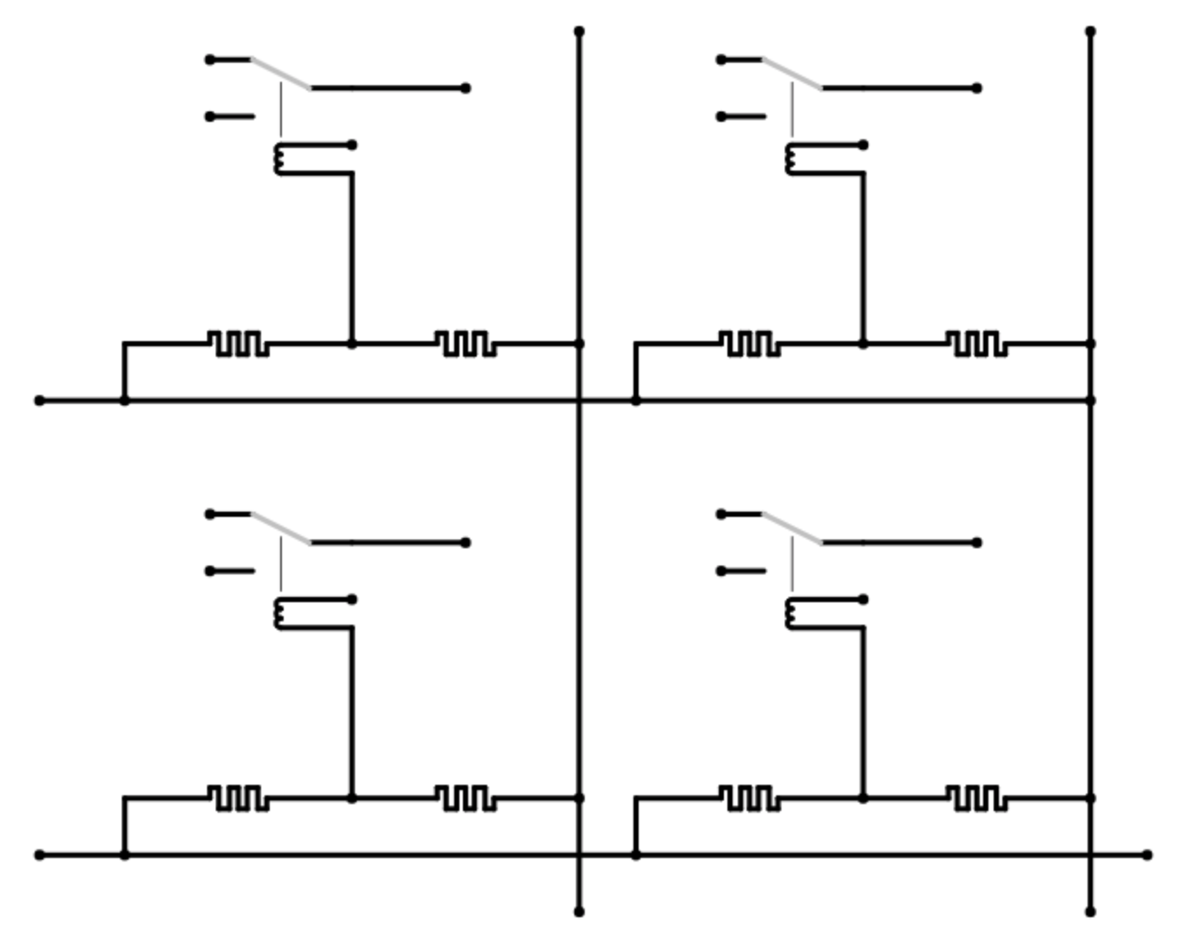
Valid state transitions
V_{col,1}
V_{col,2}
src_{1,1}
src_{1,2}
drn_{1,1}
drn_{1,2}
V_{g}
-
+
+
-
V_{row,1}
src_{2,1}
src_{2,2}
drn_{2,1}
drn_{2,2}
V_{g}
V_{row,2}
out
Hysteretic 4T NEM Router
RRAM Cell

Slide 24
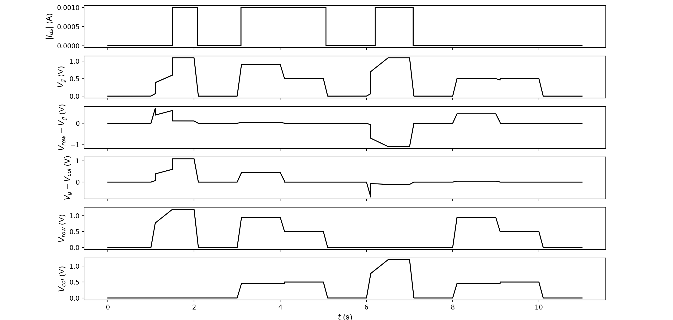
Time trace of valid state transitions in HSPICE
MODE:
OFF_0
SET
OFF_1
COPY_1
HOLD_1
OFF_1
RESET
OFF_0
COPY_0
HOLD_0
OFF_0

Slide 25
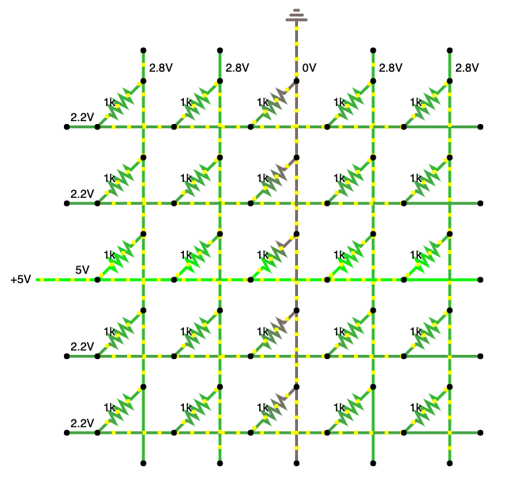
Half-select problem
Avoiding write disturbance requires RRAM to have asymmetric SET/RESET voltages
Approximately speaking:
|V_{SET}| > |V_{RST}|

Slide 26
Row/col controllers
https://www.falstad.com/circuit/circuitjs.html
Notes:
(single stream for reduced I/O pin requirement)
Probably want to do this on-chip to reduce pin requirement
Column controller is similar

Slide 27
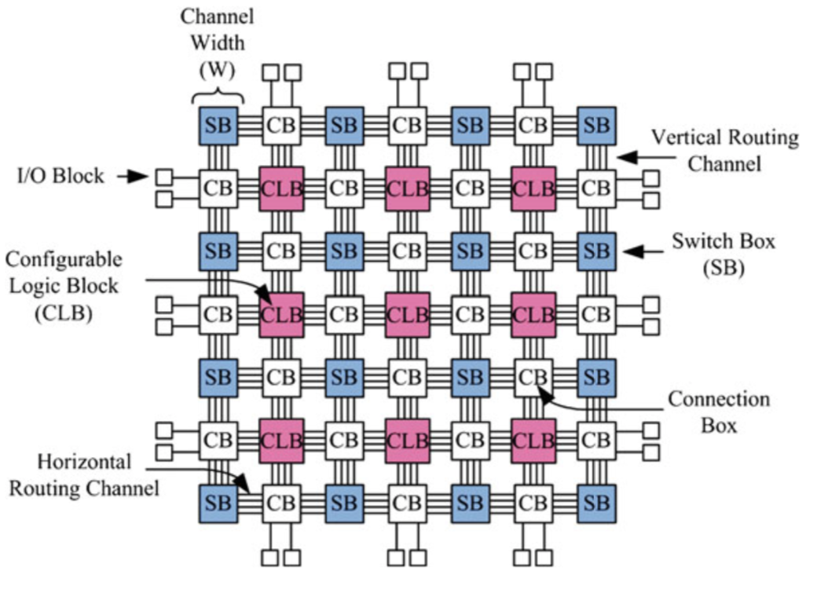
Island-Style Architecture
CB
SB
PE
CB
One CGRA Tile
Source: FPGA Architectures: An Overview - Springer
Notes:
CLB: configurable logic block
CB: connection box
SB: switch box

Slide 28
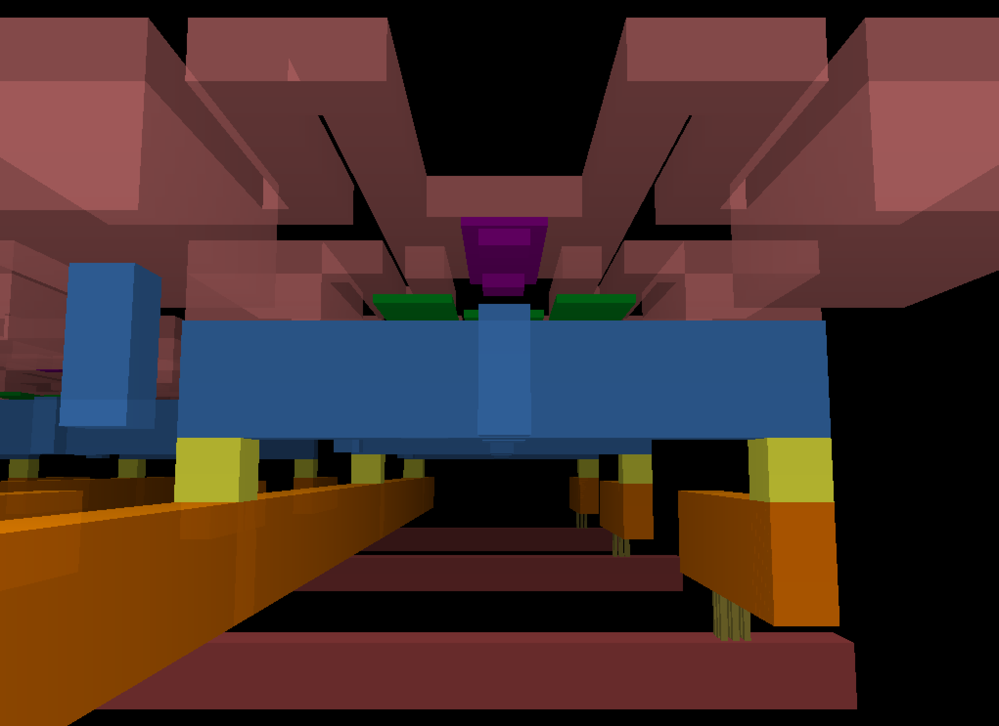
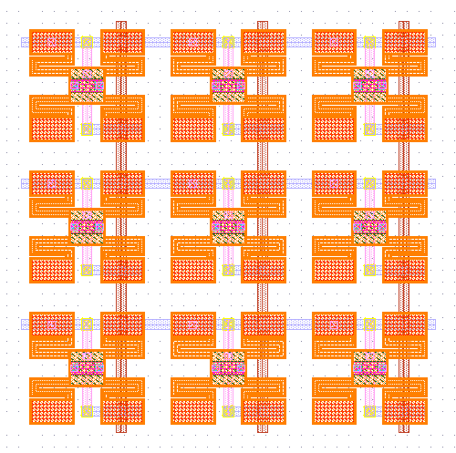
RRAM/NEMS switch layouts
NEM
Relay
Anchor
NEM
Body
NEM
Relay
Anchor
Channel
Dimple
Gate body
S/D contact
Gnd Pin for Anchor
Gate line (M9)
RRAM
RRAM
4T
Row line (M8)
Vias
Column line (M7)
Image generated with GDS3D

Slide 29
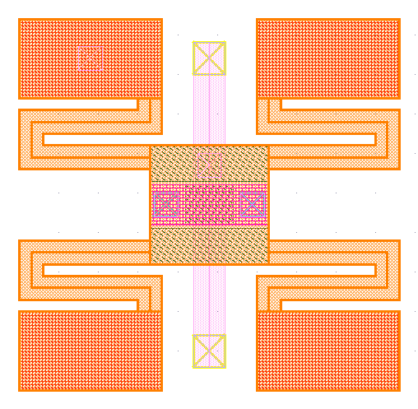
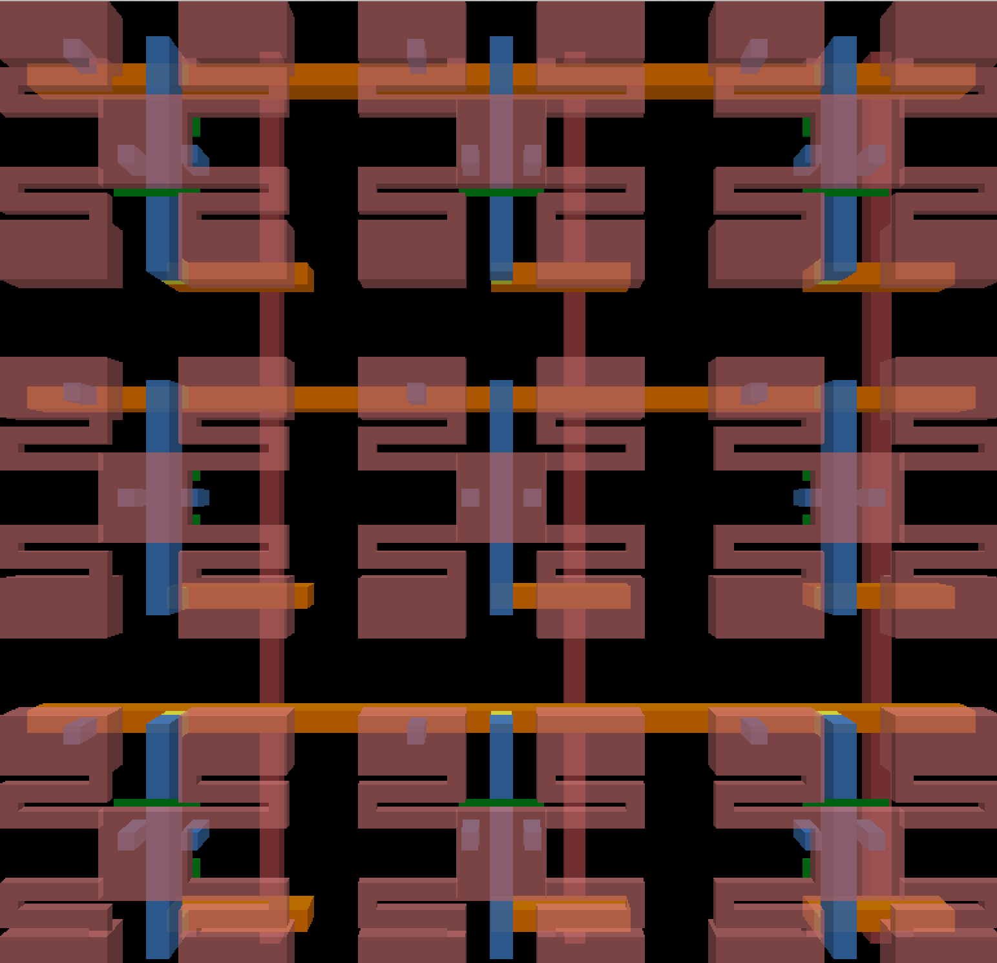
RRAM/NEMS switch layouts (~5um x 5um)
Custom technology based on SAED32 PDK. 5 new layers added: RRAM (between M8/M9), NEMDIMP, NEMANC, NEMCHAN, NEMBEAM
Notes:
TODO: add measurements on critical dimensions

Slide 30
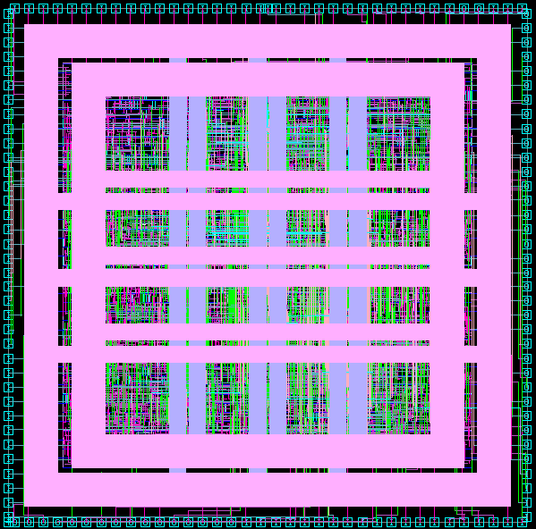
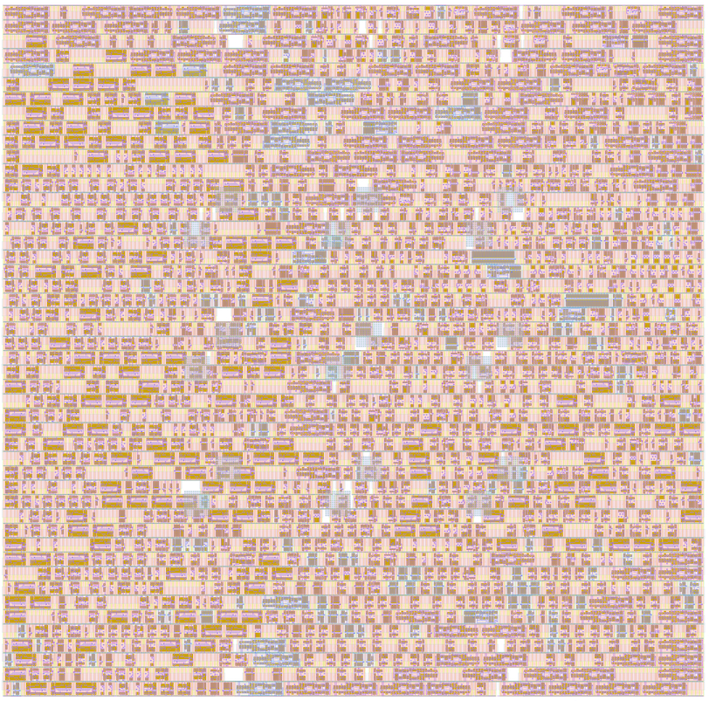
PE Tile Layouts (~90um x 90um)
View from Synopsys IC Compiler
GDSII stream-out loaded into Cadence Virtuoso

Slide 31
Switch boxes
Flexibility: Fs = 3
Source: http://venividiwiki.ee.virginia.edu/mediawiki/index.php/File:SwitchBo.png

Slide 32
Connection boxes
Fc = 0.5
PE
PE

Slide 33
Layout strategy: 3D stacking of CBs + SBs
CB
SB
CB
SB
PE
CB
PE
CB
SB + 2 CBs
SB + 2 CBs
CB
SB
CB
SB
PE
PE
PE
CB
PE
CB
CBs and SBs will be laid out using crossbar tiling of stdcells
PE will then be routed to pins in upper metal layers
Notes:
Need to get to 1/3 area for full utilization

Slide 34
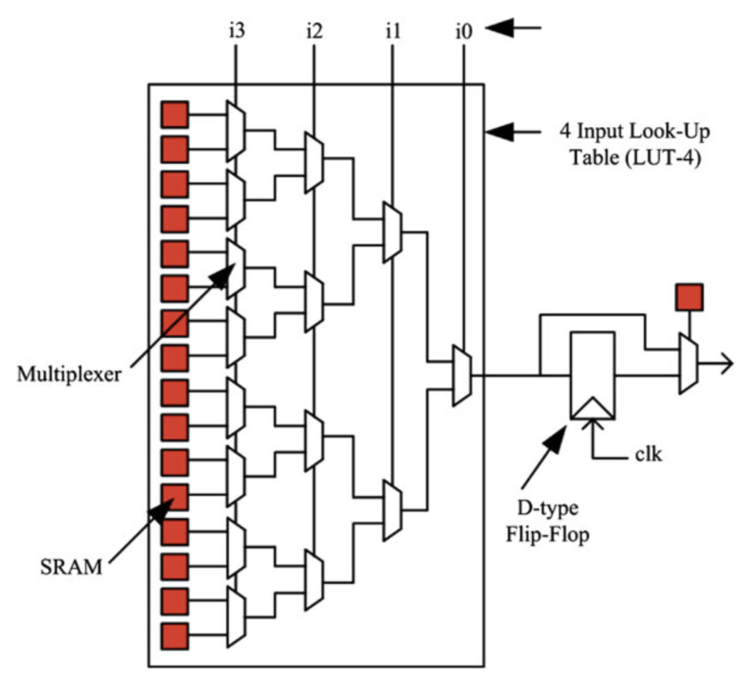
(Future Work: LUTs with RRAM/NEMS)
Key idea: replace SRAM with RRAM/NEMS but leave muxes in CMOS for speed
Source: FPGA Architectures: An Overview - Springer
Notes:
Ultimately you want all static configuration to use this architecture

Slide 35
Next Steps
Simulation & Modeling
Test with different device parameters
Test with different device models with varying levels of sophistication
Simulate NEM relay behavior using FEA tool
Optimize shape of NEM relays using FEA tool
Predict NEM relay stiction and contact resistance
More advanced NEM relay model: calibrate to experimental data too
VLSI Design
Make standard cells with different bit widths and estimate properties (V_{po}, V_{po}, endurance, etc.)
PnR to build switch boxes and connections boxes
Architectural analysis w/fully laid out blocks
Architectural Analysis
Calculate approximately what benefits are (area, energy, delay)
Build a parametrized cost model for system components (average area/energy/delay cost, given switch box parameters, size of array, etc.)
Fabrication & Characterization
Test dual-RRAM SET/RESET and voltage divider properties
Test crossbar array of dual-RRAM SET/RESET and voltage divider properties
Fabricate NEM relays with larger bit widths
Integration with AHA CGRA
Row/column drivers need to be simulated
Predict NEM relay pull-in/pull-out voltages using models
Row/column drivers need to be implemented

Slide 36
Summary
RRAM and NEM relays work well together for reconfigurable routing
100% BEOL design enables isolation of layout for routing and logic
That’s all, folks!
Area Improvements | Power Improvements | Delay Improvements
Routing components in 3D | Lower ON-state resistance | Lower ON-state resistance
Routing components require fewer elements | Low-power startup with integrated NVM | Fast startup with integrated NVM
No config registers/SRAM | Shorter wire lengths | Shorter wire lengths
 | No leakage current

